Slide 1
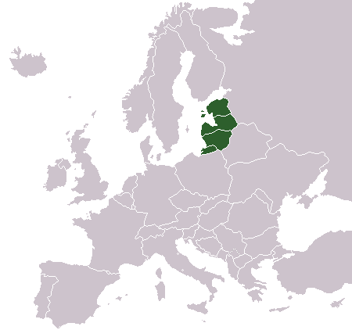
Baltic States

Slide 2
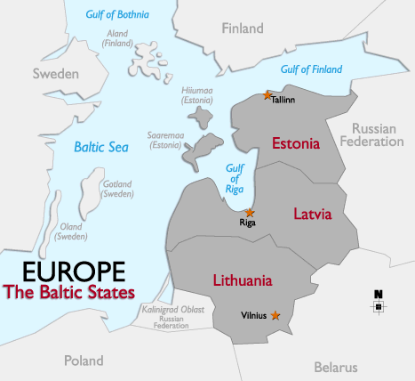



Countries
and their Capitals
Estonia
(Tallinn)
Latvia
(Riga)
Lithuania
(Vilnius)
zxasxac
Notes:
COUNTRIES AND THEIR CAPITALS
The people comprising the Baltic States have together inhabited the region for millennia, although not always peacefully.
Estonia was ruled for many centuries by Danish, Swedish, German and Russian factions.
Latvia was also controlled for many centuries by different factions – including the Russian Empire of Catherine the Great (1729-1796).
Lithuania was once a powerful force in medieval Europe but has suffered from the tragic impact of a German Invasion and almost 60 years of failed communist rule.
In recent history all three countries were subsumed within the former Soviet Union during the Cold War (after WWII to 1991) and were “Russionized”.
In 1991, the former Soviet Union released collapsed and released its grip on the Baltic States, thus separating the Communist Block from Northern Europe. The three countries promptly declared their independence and are now proud members of the European Union and the North Atlantic Treaty Organization (NATO).

Slide 3
General Informations
Country | Estonia | Latvia | Lithuania
Area | 45 227 km2 | 64 589 km2 | 65 300 km2
Population | 1.3 million | 2.3 million | 3.4 million
Notes:
GENERAL INFORMATION
-- Area of California is 164,000 sq miles (Baltic States total is 67,000 sq miles or 40% as large as California).
-- Population of California is 37 million Vs 7 million (Baltic States has about 20% of the population of California).
-- California’s Gross State Product is $1.8 trillion Vs. $1.1 million for the Baltic States. Baltic States (6% of California’s GSP). But, remember that California has the 8th largest economy in the world.

Slide 4
Government, Currency,
Language and Religion
Country | Estonia | Latvia | Lithuania
Form of Government | Parliamentary Democracy | Parliamentary Democracy | Parliamentary Democracy
Currency | Euro | Euro | Euro
Language | Estonian Russian German English | Latvian Russian German English | Lithuanian Russian -- English
Religion | Lutheran, Catholic, Orthodox | Lutheran, Catholic, Orthodox | Catholic, Orthodox, Lutheran
Notes:
GOVERNMENT, CURRENCY, LANGUAGE AND RELIGION
--All three countries are parliamentary democracies (i.e., the political power is held by an elected parliament representing the people) , which have unicameral parliaments that are elected by popular vote to serve four-year terms
In Latvia and Estonia, the President is elected by parliament.
In Lithuania, the President is elected by popular vote.
-- Each state currently has its own currency. So, traveling from country to country requires exchanging money for local currency.
-- The Estonian language belongs to the Finno-Ugric languages (close ties to the Finnish language).
-- Latvian and Lithuanian languages belong to the Indo-European languages.
-- The Russian language is spoken in all three countries as a consequence of these countries having been absorbed into the Soviet Union at one point. Between ¼ and 1/3rd of the population of Estonia and Latvia are Russian immigrants.
-- German is spoken in Estonia and Latvia due to the long period of Germanic domination, starting in the Middle Ages.
-- In Estonia and Latvia, Lutheran is the faith most widely practiced, followed by Catholic and Russian Orthodox. In Lithuania, Catholic is the predominant language, followed by Russian Orthodox and then Lutheran.

Slide 5
Brief Recent History
18th century – Russian Empire gained control
1920 Baltic States became independent countries
1940 Red Army occupied Baltic States
1941 Nazi Germany occupied Baltic States
1944 Red Army reoccupied Baltic States
After WWII, Baltic States became part of the Soviet Union
1991 The former Soviet Union recognized the Baltic States as being independent
All of the Baltic States are now members of the EU
Notes:
BRIEF RECENT HISTORY
Here is a very brief summary of some important historical events in modern Baltic States history.
Background--
13th century – Invasion of crusaders from west ushered in Christianity and feudalism into Estonia and Latvia and the conversion from Paganism to Christianity in Lithuania.
The Russian Empire gained control of most of the present-day Baltic states in the 18th century when the Polish-Lithuanian Commonwealth was partitioned in three stages by the Russian Empire, the Kingdom of Prussia, and the Habsburg Monarchy, while western parts of Lithuania were incorporated into Prussia.
Estonia, Latvia and Lithuania became sovereign nations in the aftermath of World War I. They declared independence in 1918, fought independence wars against German Freikorps and Bolshevist Russia, and were recognized as independent countries in 1920.
In June 1940, the Red Army occupied the whole territory of Estonia, Latvia, and Lithuania, and installed new, pro-Soviet governments in all three countries.
Following rigged elections, in which only pro-communist candidates were allowed to run, the newly "elected" parliaments of the three countries formally applied to "join" the USSR in August 1940 and were annexed into it as the Estonian SSR, the Latvian SSR, and the Lithuanian SSR.
The Soviet control of the Baltic states was interrupted by Nazi German invasion of the region in 1941. The German occupation lasted until late 1944 (in Courland, until early 1945), when the countries were re-occupied by the Red Army.
In the late 1980s massive demonstrations against the Soviet regime, known as the Singing revolution began (non-violent protests).
One of the most noted protests took place on August 23, 1989, when approximately two million people joined their hands to form a 600-kilometer human chain across the three countries in the event known as the Baltic Way.
The three Baltic nations re-declared their independence in 1990 and 1991, and their independence was recognized by the Soviet Union on September 6, 1991.
Feudalism: A system of landholding, common throughout Europe in medieval times, whereby freehold land was held or occupied in return for personal service to a lord or goods paid in kind, assured by oaths of homage.

Slide 6
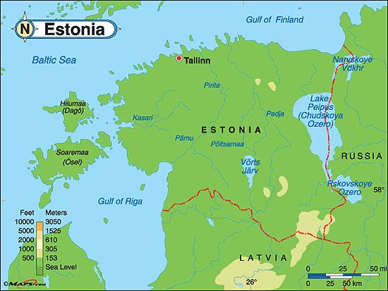
ESTONIA

Slide 7
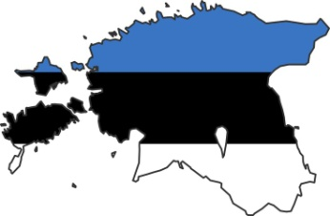
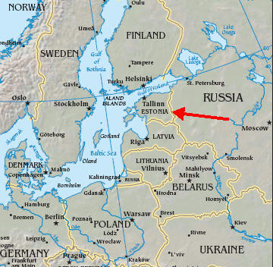
Location of Estonia
Estonia is the first – and the smallest - of the three Baltic states.
It is bordered on the east by Russia, on the south by Latvia, and on the west and north by the Baltic Sea.

Slide 8
Geography of Estonia
Estonia consists mostly of flat or gently rolling land. The highest point in Estonia is only 318 m above sea level. The 70% of the country comprises forest.
There are two large islands and other smaller ones. Rivers are short, the Pärnu is the most important. There are more than 1400 small lakes. Lake Peipus forms part of the border with Russia.
Estonia’s climate is cold continental, but tempered by the sea.

Slide 9
Economy of Estonia
Much of the cultivated land is devoted to such typical northern European crops as barley, wheat, rye (segale), potatoes, and flax (lino). Other land is planted with fodder.
Machines and electronic items are the chief manufactured products. Also important are textile making, food processing, and the production of paper.
Tallinn is the site of Estonia's chief commercial port and main airport. Tallinn and Pärnu are the chief fishing ports. Rail and road transportation in Estonia is well developed.

Slide 10
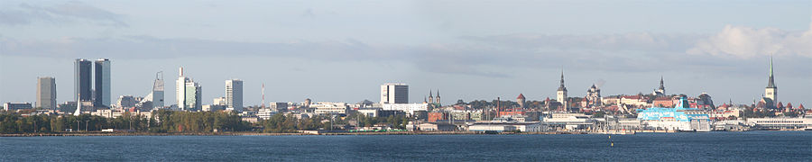
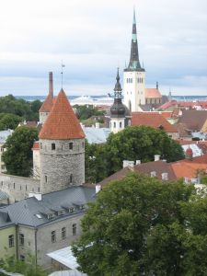
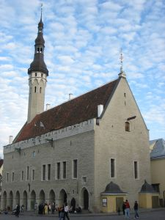
Tallin
The city was known as Reval from the 13th century until 1917.
Tallinn's old town is placed on the UNESCO World Heritage List.

Slide 11
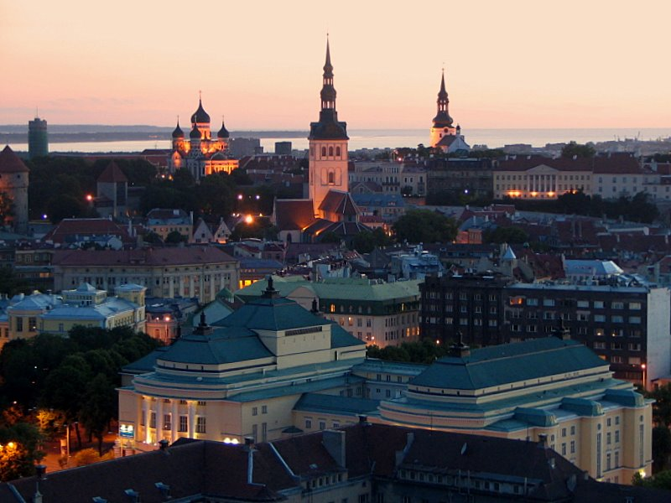
Tallin
Notes:
Tallinn, Estonia's crown jewel, is Estonia’s capital city.
It is the largest city in Estonia with a population of 410,000 people.
It lies on the banks of the Gulf of Finland and began as an important port in the 14th century.
Tallinn was an important port for a German 14th century trade league called the Hanseatic League, and the wealth the trade brought the city is still evident.
It has a wonderful old town with a maze of cobblestone streets.
At every turn, you see church spires, tiny passages and cafes.

Slide 12
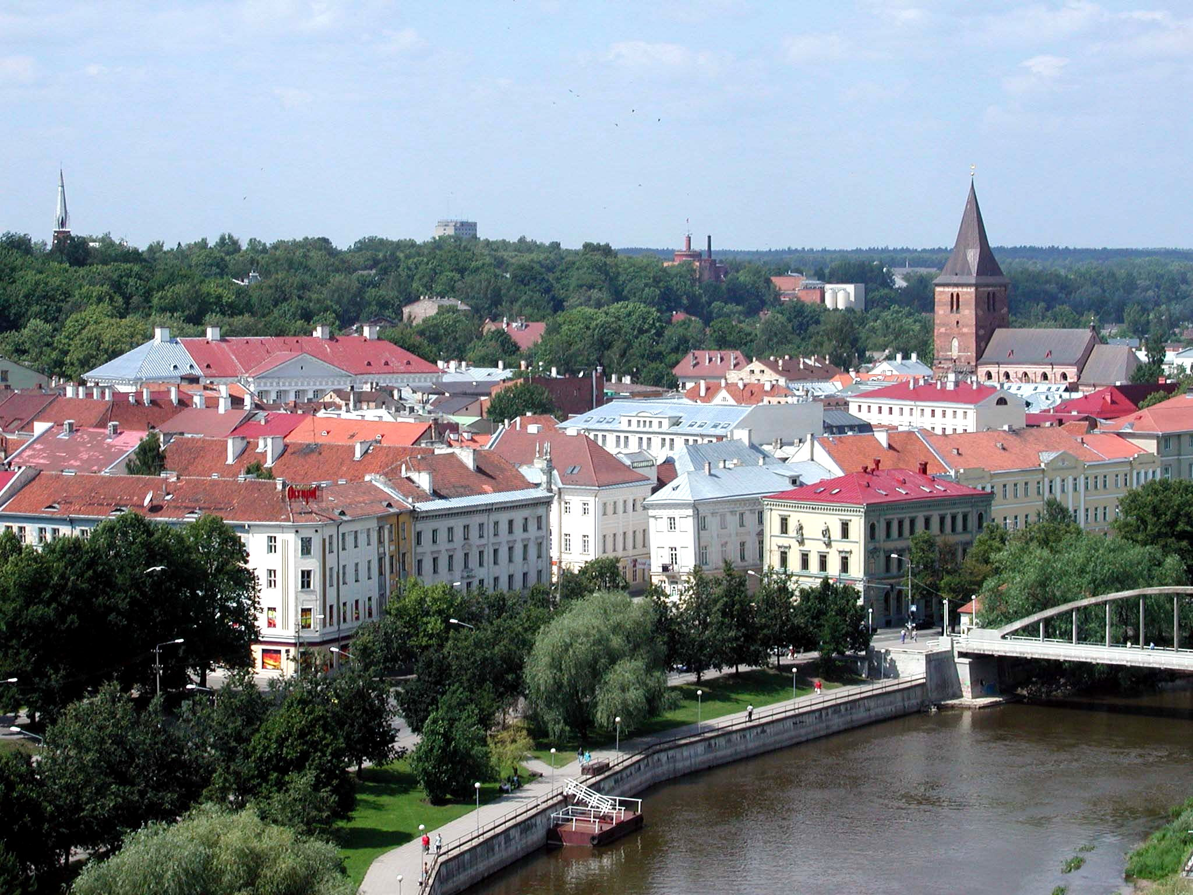
Tartu
Notes:
Tartu is Estonia’s second largest city with a population of about 100,000 people.
It is known by locals as Estonia's spiritual capital as the Locals talk about a special Tartu vaim (spirit) inhabiting its 19th-century streets, old wooden houses, green parks and peaceful riverfront.
Small and quaint, with the quietly flowing Emajõgi River running through it.
Tartu is also Estonia’s premier university town, with students making up nearly one-fifth of the population. It is home to Estonia’s oldest university.
The city escaped much of the “Russionization” that occurred in other cities in Estonia.
Today, there are many gallaries, museums and cafes.

Slide 13
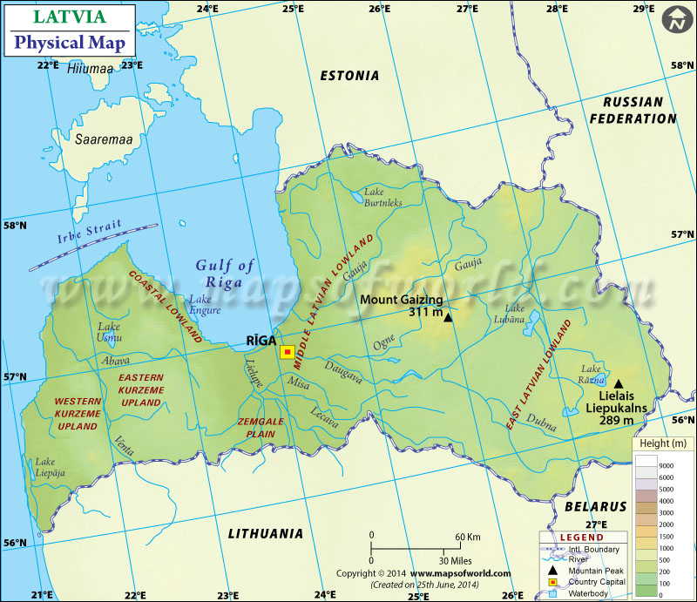
LATVIA

Slide 14
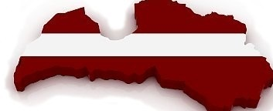
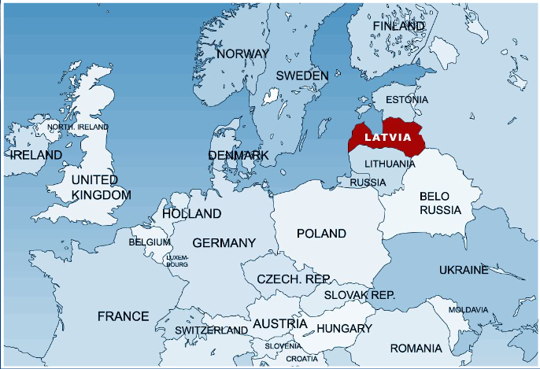
Location of Latvia
Latvia is the central country of the Baltic States.
Latvia is bordered by
Estonia to the north,
Russia to the east,
Lithuania to the south
and the Baltic Sea
to the west.

Slide 15
Geography of Latvia
Most of the land is flat but in some areas there are glacial hills, some reaching as much as (300 m) above sea level.
There are many small glacial lakes.
Latvia's largest river is the Western Dvina (or Daugava), which flows from Belarus to the Gulf of Riga.
Latvia's climate is cold continental, but tempered by the sea.

Slide 16
Economy of Latvia
Forests provide timber. The main crops include oats, barley, rye, sugar beets, potatoes, and fodder. Bovine and swine breeding is also important, as well as fishing (especially of herrings)
Major industries include the manufacturing of railway cars and locomotives, telephone equipment, scientific instruments, chemicals, and textiles. Other industries include shipbuilding, food processing and the manufacturing of paper and wood products. Riga, the capital, is the main industrial center.
Latvia's rail and highway networks are extensive. Riga is a Baltic port and has the nation's largest airport. Most raw materials are imported.

Slide 17
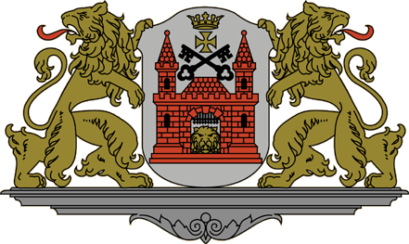
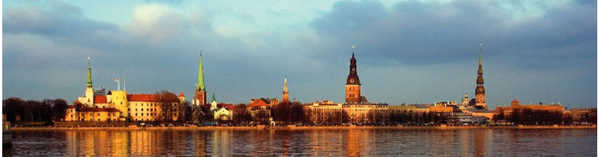
Riga
The capital of Latvia is Riga.
Latvia’s political, economical and cultural centre.
One third of Latvia’s population lives and works in Riga.

Slide 18
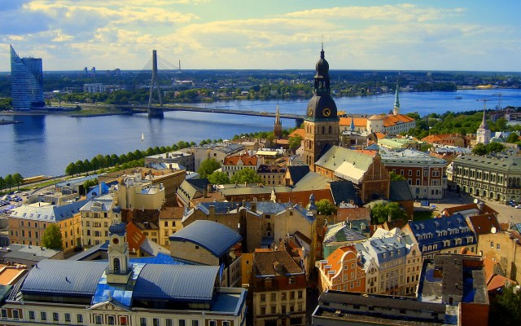
Riga

Slide 19
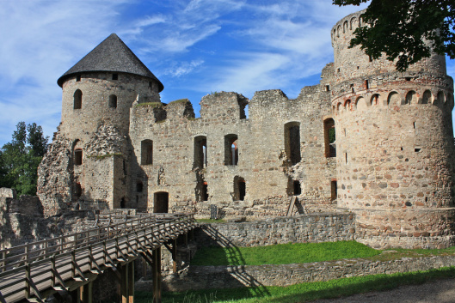
Cesis castle

Slide 20
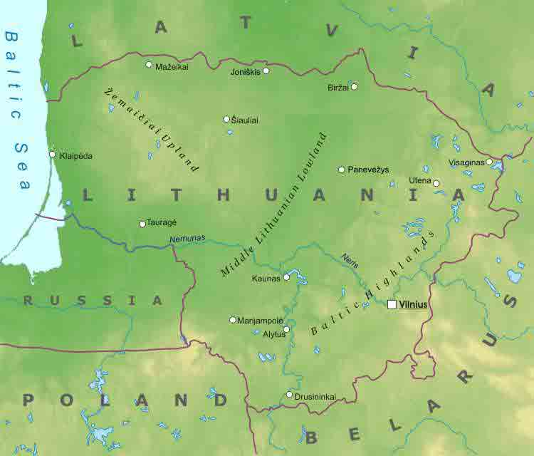
LITHUANIA

Slide 21
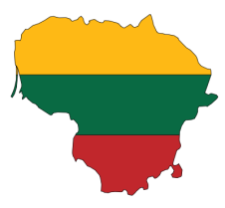
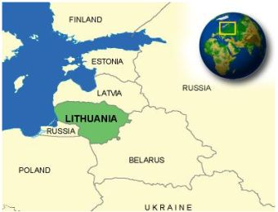
Location of Lithuania
Lithuania is the third and the biggest of the three Baltic states.
It is bordered by Latvia to the north, Belarus to the east, Poland and Russia to the south, the Baltic Sea to the west.

Slide 22
Geography of Lithuania
The surface is generally flat and low. Glacial hills rise gradually to more than 270 m above sea level in the east.
There are small glacial lakes. The Neman (or Nemunas) is the country's principal river. It flows from Belarus to the Baltic Sea.
Because of the sea's tempering influence, Lithuania's climate is moderately continental. Winters are cold and summers are cool.

Slide 23
Economy of Lithuania
Main crops include rye, barley, wheat, potatoes, sugar beet, and flax. Bovine and swine breeding is also important. Lithuania is especially noted for its production of meat and dairy products.
The main manufactured products are machinery, precision instruments, chemicals, paper, plastics and textiles. The shipping, woodworking, electronics, and food-processing industries are also important.
Rail and road transportation are well developed. There are 3 airports; Klaipeda is Lithuania's only seaport.

Slide 24
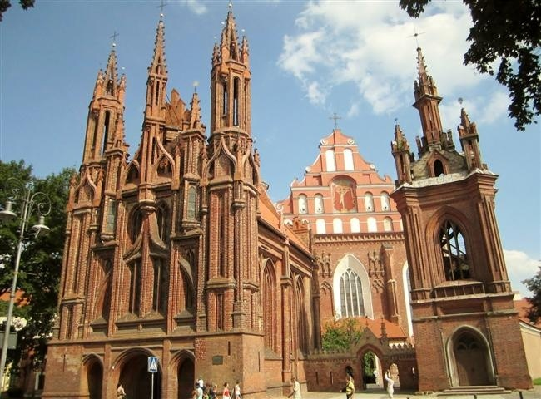
Vilnius
Vilnius, the capital of Lithuania, was declared UNESCO World Heritage Site in 1994.
For its big Jewish community, it was known as “the Jerusalem of Lithuania.

Slide 25
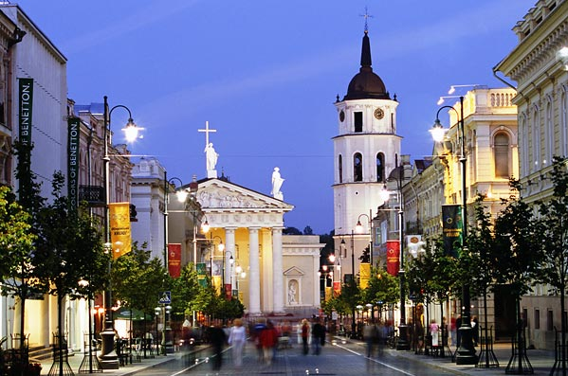
Vilnius

Slide 26
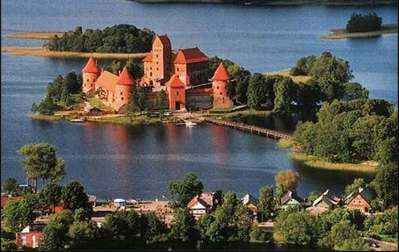
Trakai Castle

Slide 27
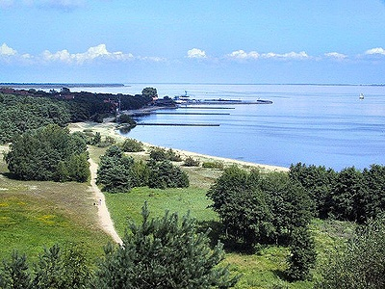
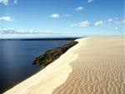
The Curonian Spit
A peninsula separating the Curonian Lagoon
from the Baltic Sea
Notes:
The Curonian Spit is a 60-mile long strip of land and sand dunes lying between the Baltic Sea on its west and the Curonian Lagoon on the east.
It was formed 5,000 years ago and is currently a National Park and a UNESCO world heritage site.
In the 9th thru 11th centuries, it was a major pegan center.
It is part Russian and part Lithuanian territory – 2 Russian and 7 Lithuanian settlements.
Today, visitors are attracted by its quietness, cleanliness and relaxing atmosphere with unique landscape.
It has the highest moving sand dunes in Europe (some 200 feet high)

Slide 28
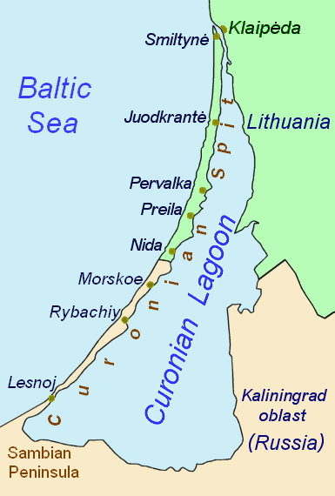
The Curonian Lagoon
between Lithuiania
and the Kaliningrad oblast
(part of Russia)

