Slide 1
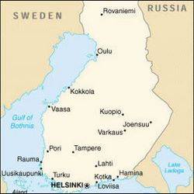
FINLAND
By Maria Fantini e Martina Torretta

Slide 2
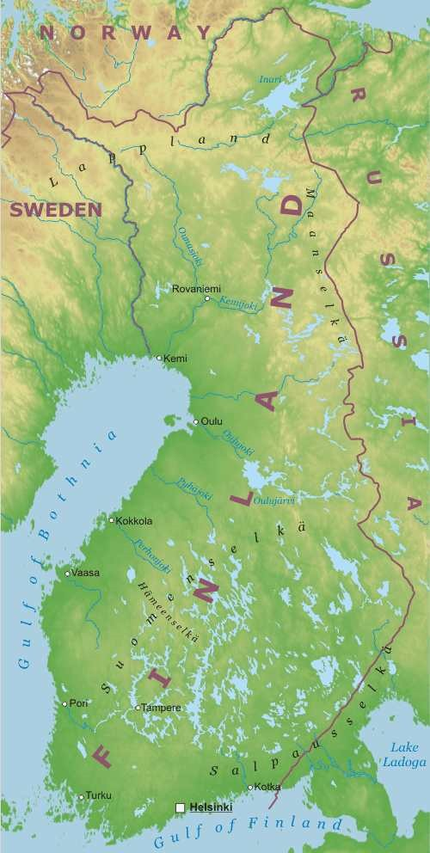
BORDERS AND TERRITORY
Finland borders with Norway on to the West and on to the North; with Sweden on to the West; with the Baltic Sea on to the West and on to the South, and with Russia on to the East.
About the territory, in Finland there are plains with a lot of lakes and low hills.
Finland’s size is 338 145 square km.

Slide 3
RIVERS AND LAKES
The main lakes are the Saimaa, the Päijänne and the lInari. While the main rivers, which are very short, are the Torne, the Kemi, the Muonio and the Oulu.
In winter most of the lakes are ice over.

Slide 4
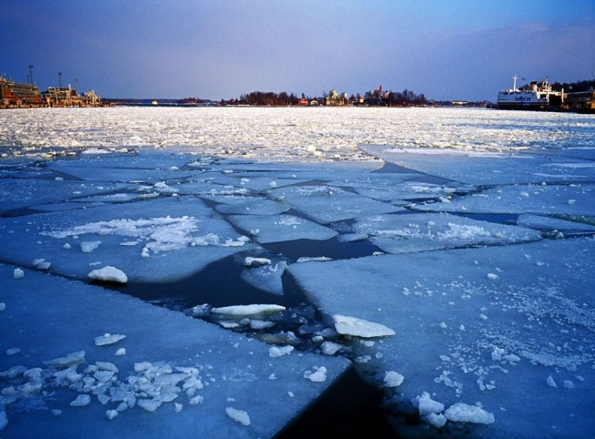
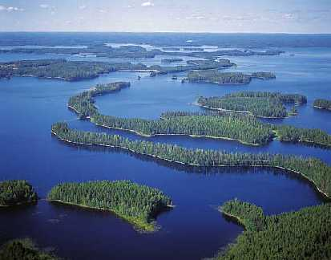
SUMMER
WINTER

Slide 5
CLIMATE
The climate is cold temperate but
IT’S RELATIVELY MILD
BECAUSE OF THE MODERATING INFLUENCE OF THE NORTH ATLANTIC CURRENT

Slide 6
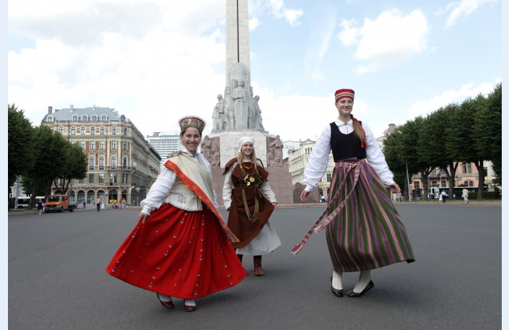
POPULATION
In Finland there are 5.428.130 people. The population density is 16 people per square km.
These are typical dresses

Slide 7
LANGUAGES AND RELIGIONS
The 92% of the population speaks Finnish, 5.5% speaks Swedish, while the 2.5% speaks other languages.
The 84.2% of the population is Lutheran. There are minorities of Catholics and Greek Orthodox.

Slide 8
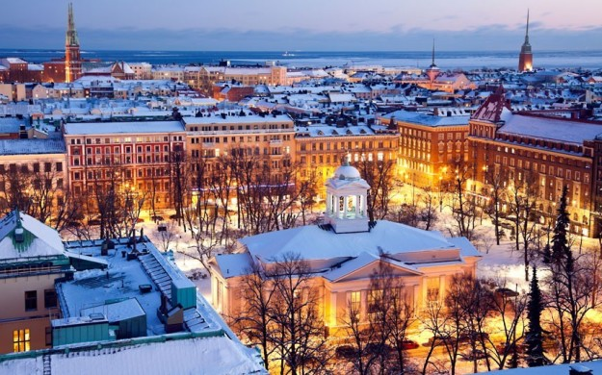
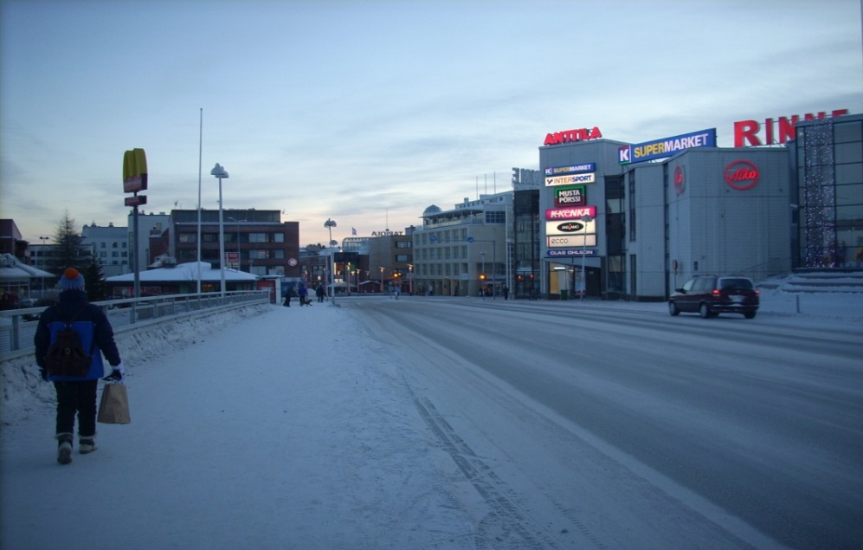
MAIN CITIES
This is Helsinki,
the capital city of Finland.
This is Rovaniemi

Slide 9
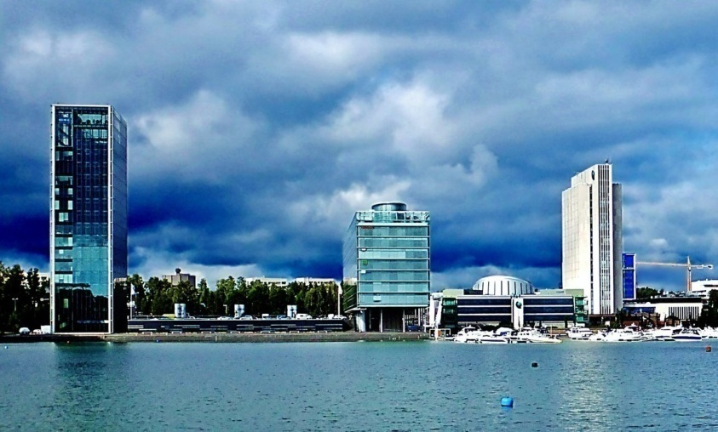
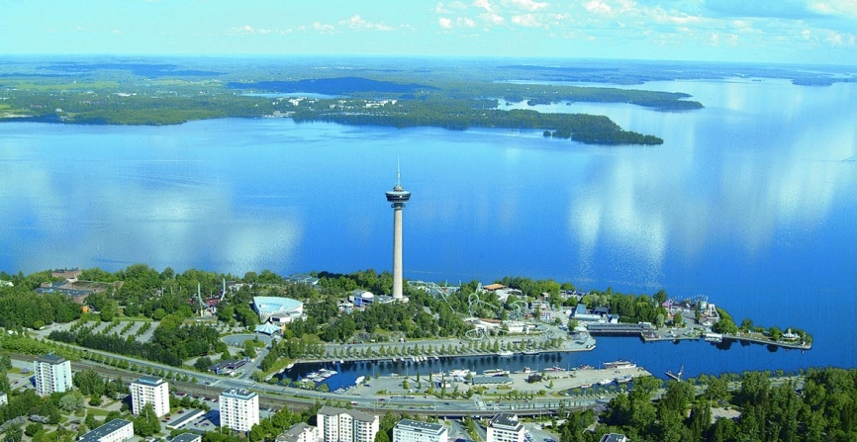
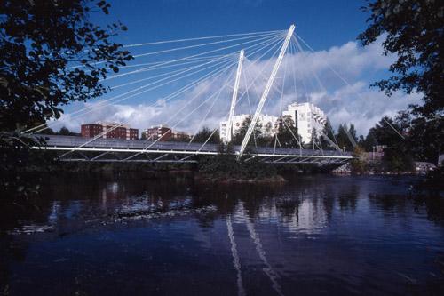
This is Espoo
This is Tampere
This is Vantaa

Slide 10
HISTORY
For many centuries it was part of the Kingdom of Sweden. In the XIX th century it was conquered by Russia, but on 6ͭ ͪ December 1917 Finland becomed independent from Russia.

Slide 11
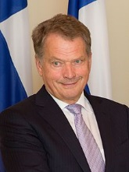
GOVERNMENT AND ECONOMY
Finland is a Republic.
Administratively it’s divided into six provinces
Finland accelerated the pace of its industrialization after World War II.
Manufacturing, services, trade and transportation are the main sectors of the economy.
Sauli Väinämö Niinistö is
the President of Finland.

Slide 12
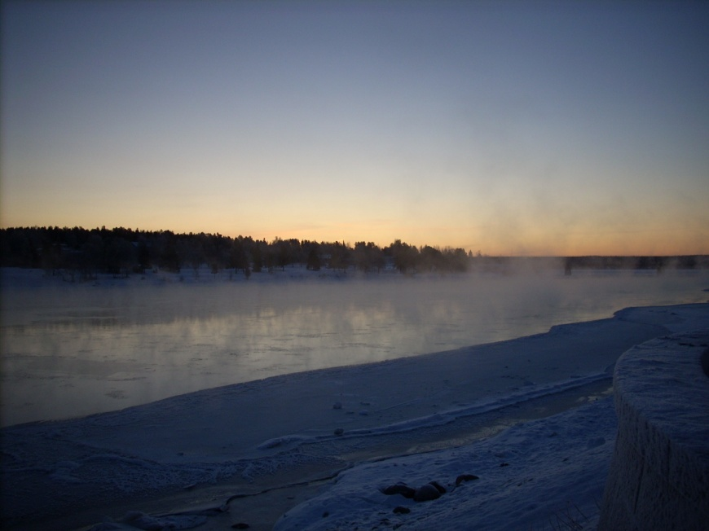
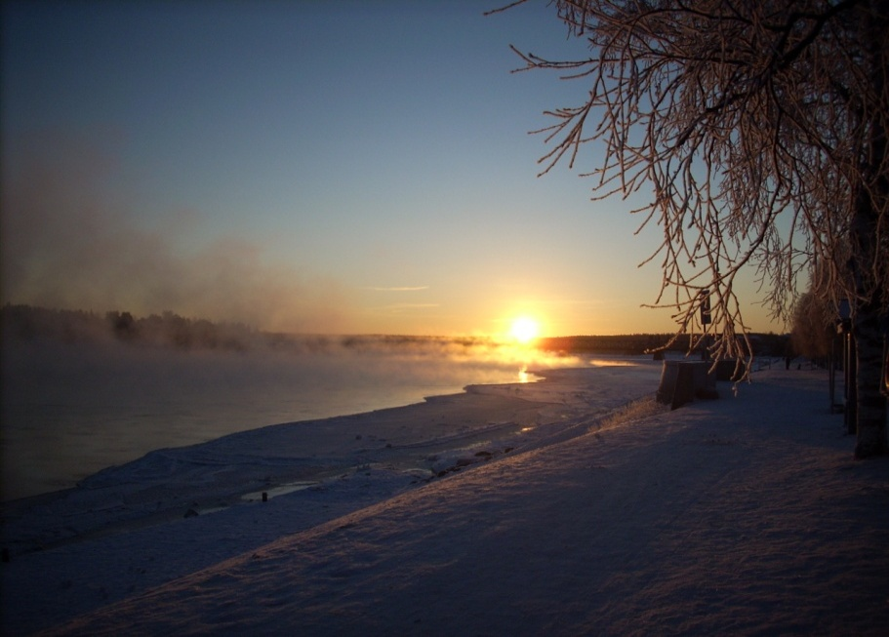
CURIOSITIES
MIDNIGHT SUN
The white summers nights are Finland’s most iconic natural phenomena.

Slide 13
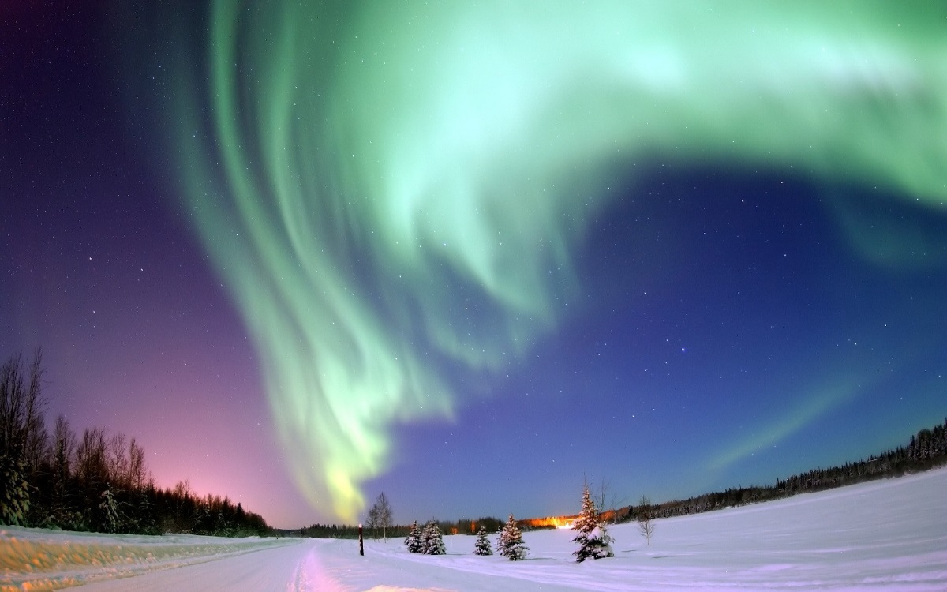
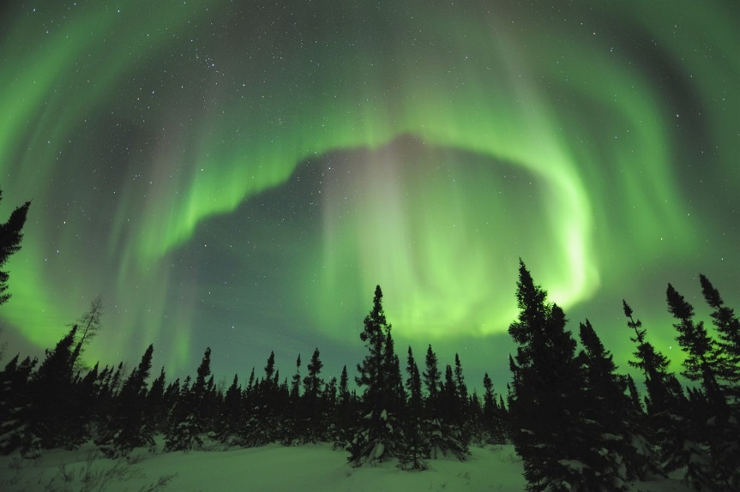
BOREAL AURORA
Boreal Aurora is an optical phenomenon in the sky during the night.

Slide 14
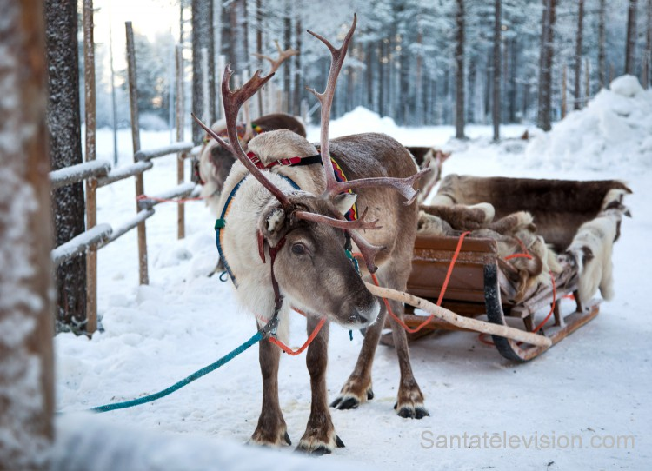
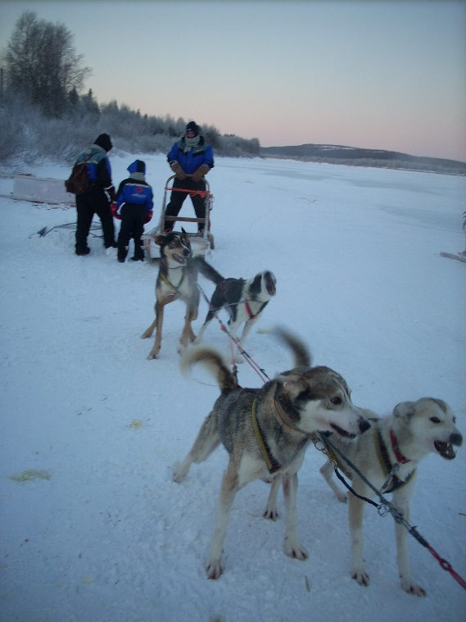
TYPICAL ANIMALS
              A typical animal is reindeer
Another typical animal is husky

Slide 15
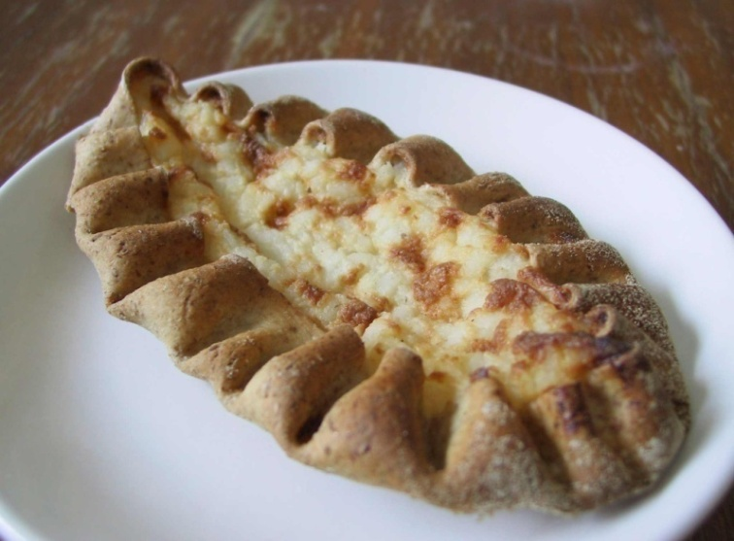
CUISINE
KARJALANPIIRAKKA or Karelian pies.
The crust was traditionally
made with rye flour and
filled with potatoes, rice
or carrots. They are
particularly delicious with
an egg butter spread on top!

Slide 16
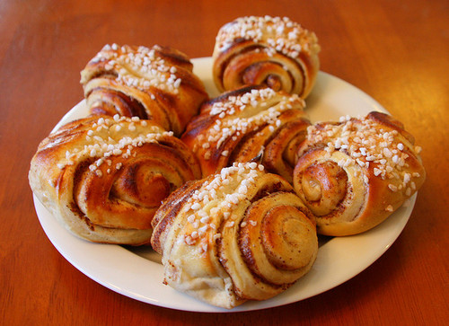
KORVAPUUSTI
They are usually eaten with a cup of coffee (Finns consume more coffee and perhaps more cinnamon buns than any other European nation), it is difficult to stop at just one. Or two.

Slide 17
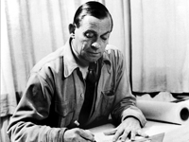
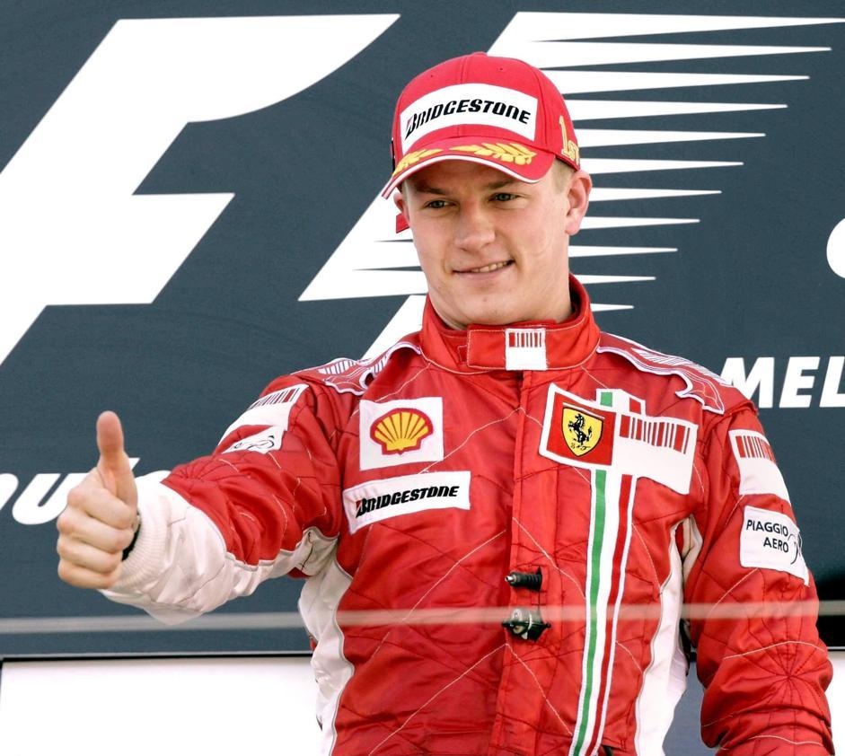
FAMOUS PEOPLE
ALVAR AALTO is a very famous Finnish designer.
RAYKKONEN is a famous
car driver.

