Slide 1
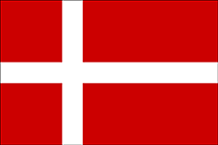
DENMARK

Slide 2
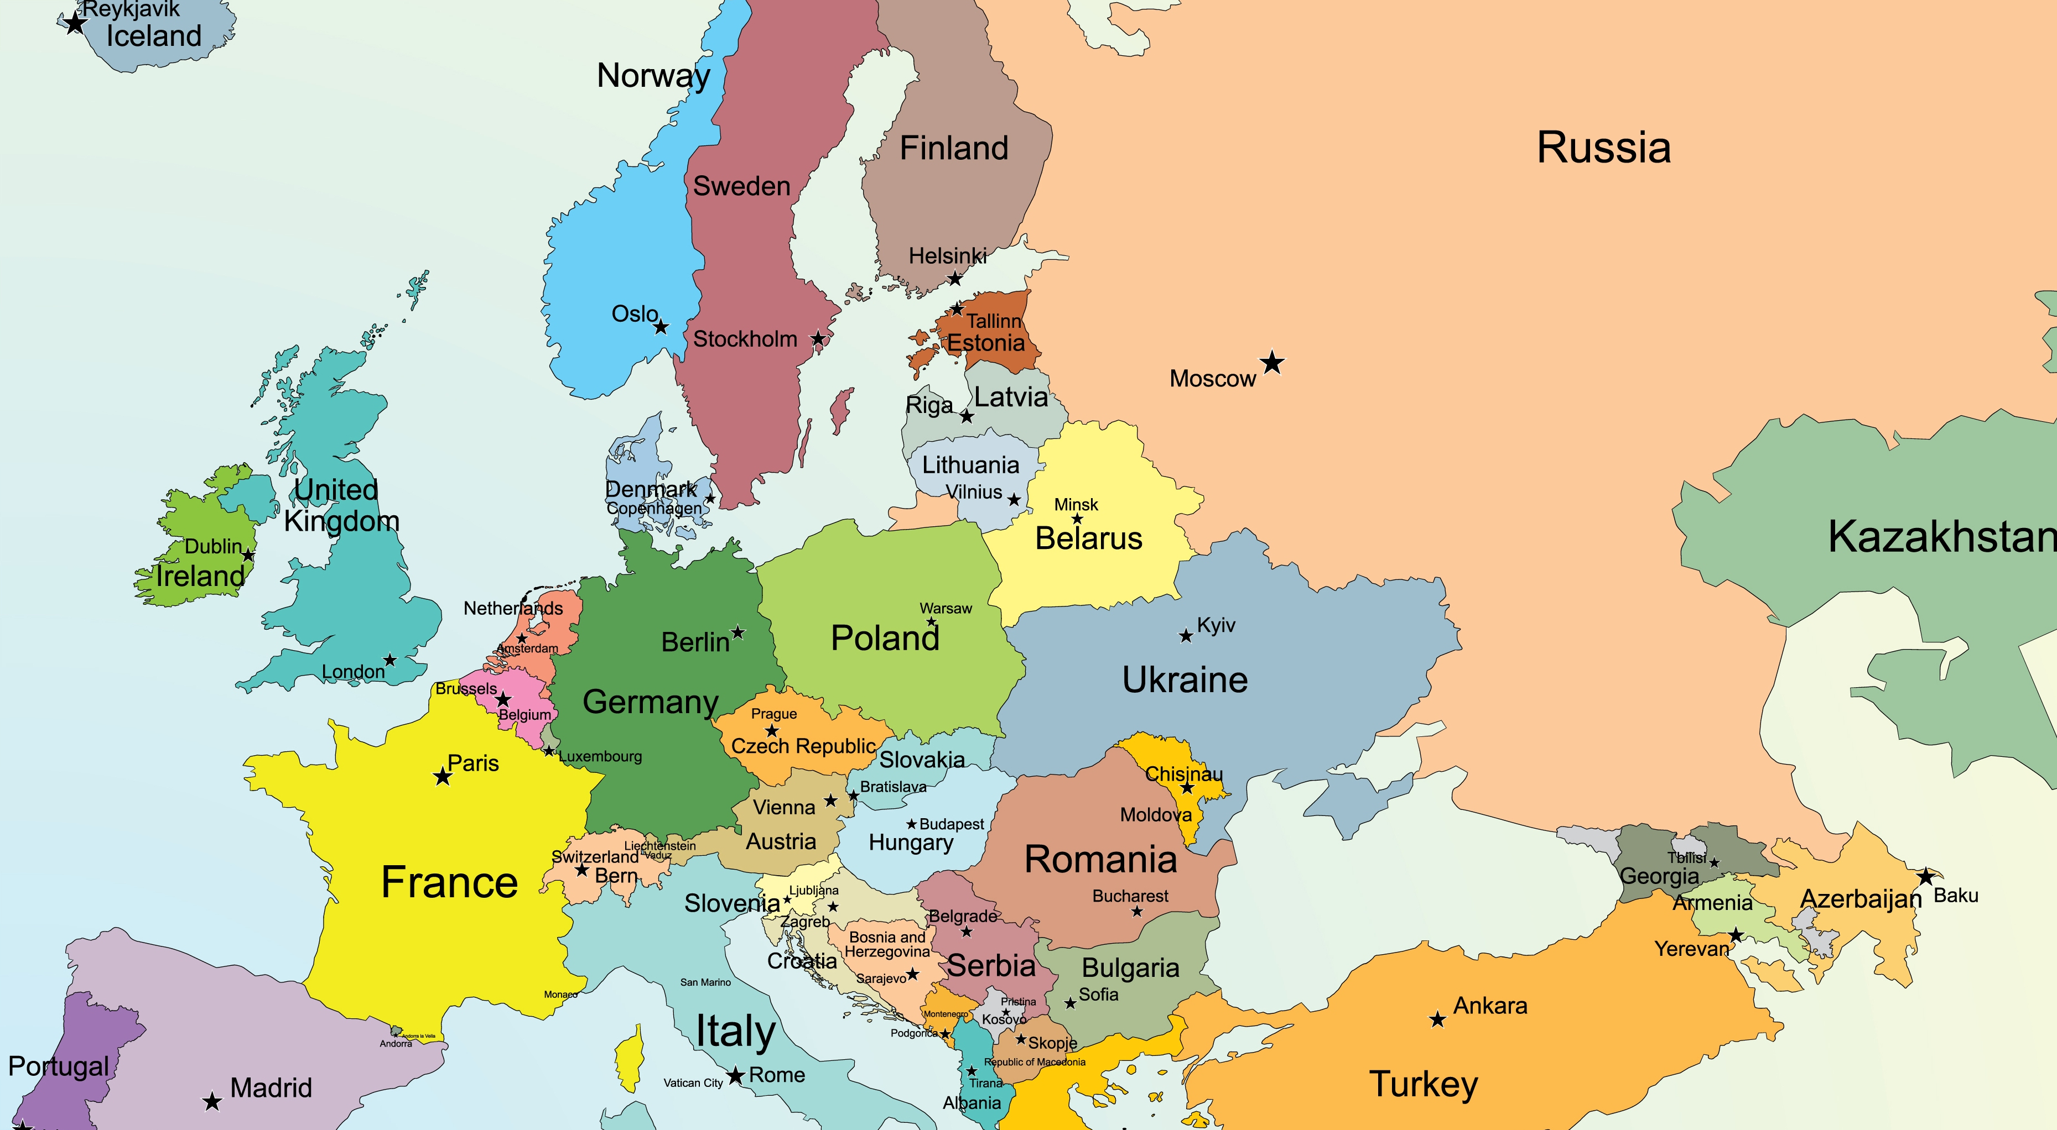
Political map of Europe

Slide 3
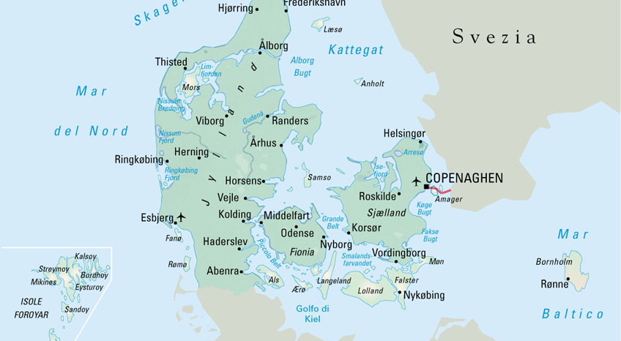
DENMARK

Slide 4
The Landscape
It’s very characteristic:
- moorlands alternate with forests
- the country has about 7.500 miles of coastline

Slide 5
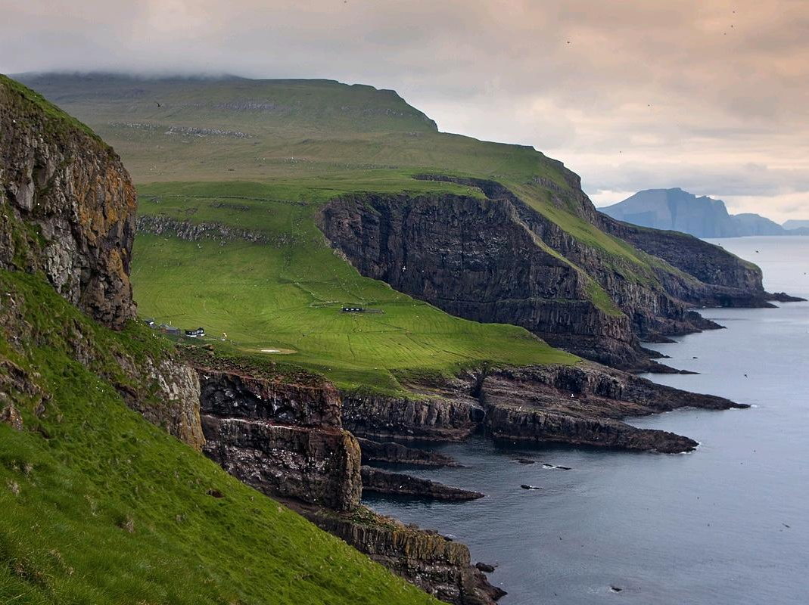
:

Slide 6
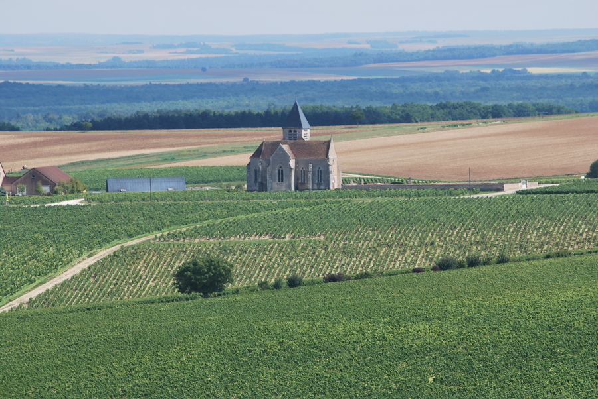

Slide 7
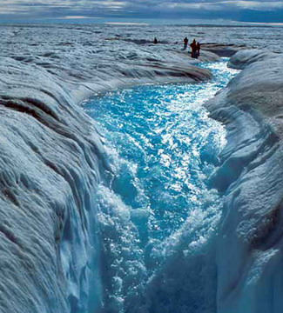
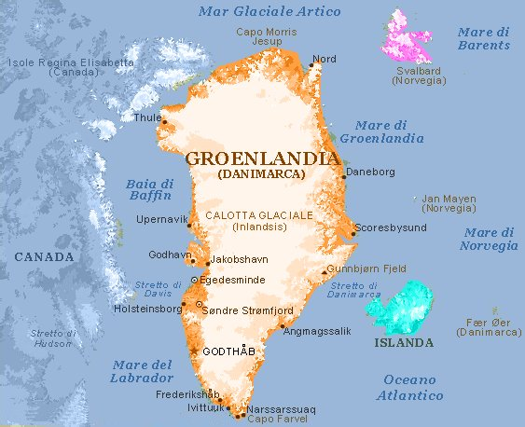
Also belongs to Denmark
GREENLAND:
the largest island in the Arctic Ocean, entirely covered with ice

Slide 8
The Climate
It’s atlantic:
The winters are not particularly cold and the average temperature in January and February is around 0 ° C , while the summers are cool with an average temperature in August of 15.7 ° C

Slide 9
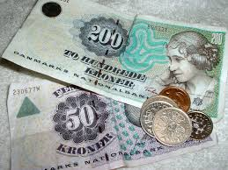
Human Geography
Populations: 5.484.723
Languages: Danish, Greenlandic (Inuit dialect), German; English is the predominant second language
Ethnicity/race: Scandinavian, Inuit, German, Turkish, Iranian, Somali
Monetary unit: Krone
Religions: Evangelical Lutherans 95%, other Protestants and Roman Catholics 3%, Muslims 2%

Slide 10
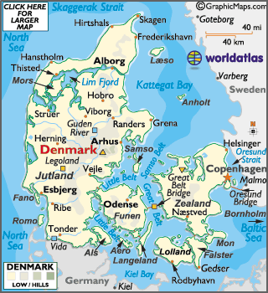
Main Towns

Slide 11
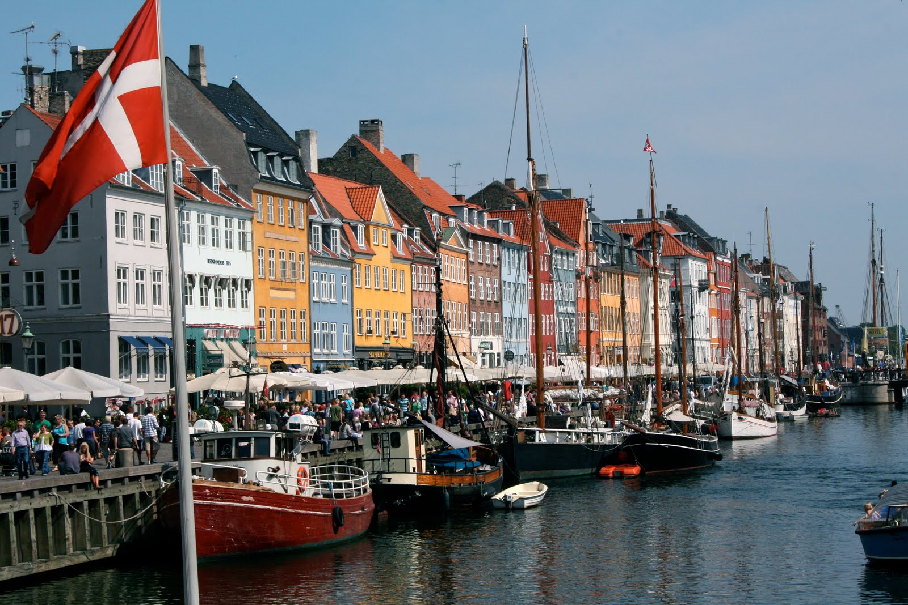
Copenhagen

Slide 12
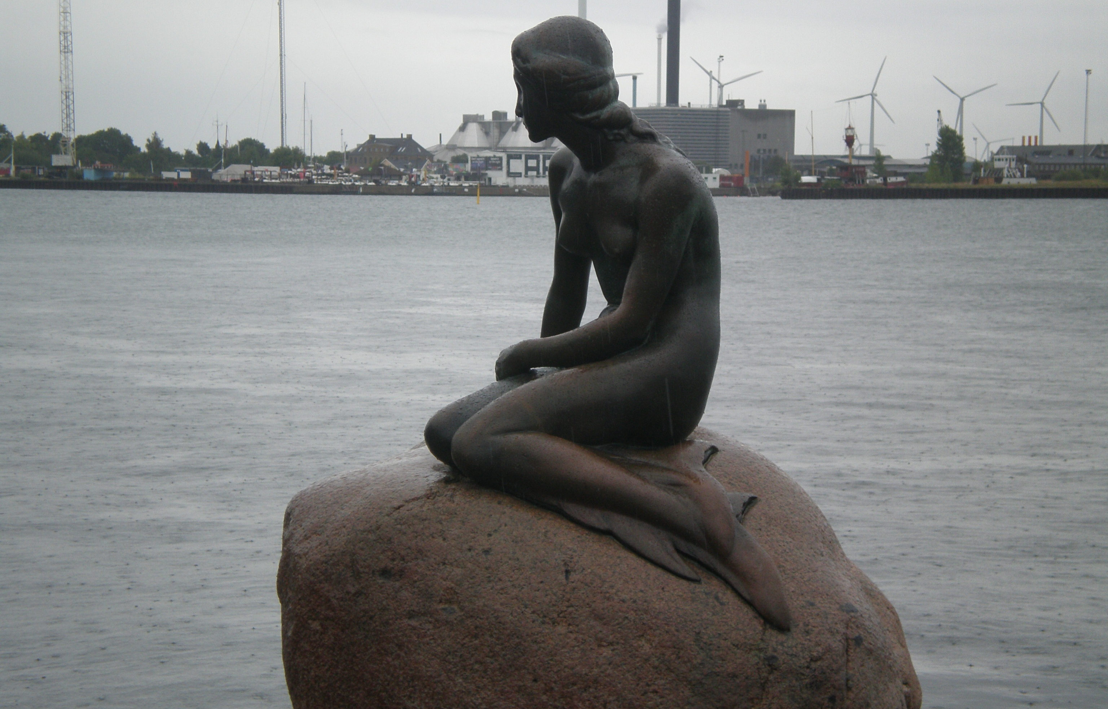
“La Sirenetta”: the symbol of Copenhagen

Slide 13
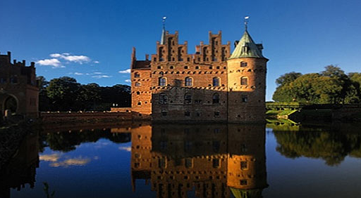
Tourist Attractions in Odense

Slide 14
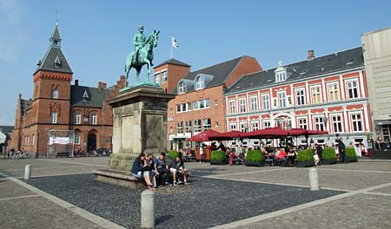
Esbjerg

Slide 15
History (1)
Around the fifth century A.D. Scandinavian populations colonized Denmark. After about two hundred years the Danes began the conquest of England .
Around the ninth century A.D. Denmark conquered Norway and some region of northern Germany, and after a few more years Danes will conquer the whole of Britain. And on 1400 also Sweden .
On 1523 Sweden gained independence rebelling against foreign Danish domination.
On 800 the new Danish monarchy shook an important alliance with Napoleon , this however, as a result of the Treaty of Kiel , led to the loss of Norway in favor of Sweden.

Slide 16
History (2)
In 1864, Austria and Prussia declared war on Denmark: that led to a new defeat of Denmark which, this time, was forced to cede most of the territories
The Constitution of Denmark was signed in 1849, ending the absolute monarchy which had begun in 1660.
The Kingdom of Denmark is a constitutional monarchy that has as head of state Queen Margrethe II
The government and national parliament are seated in Copenhagen.
In 1972, Denmark joined the European Community, and then refused to adopt the euro in 2000.

Slide 17
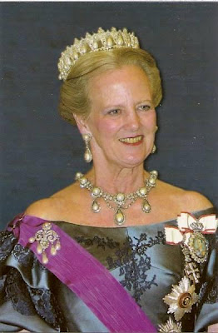
Queen Margrethe II

Slide 18
Economy
PRIMARY SECTOR:
The flat area creates the best conditions for farming and agriculture:
1) Agricultural products: barley, wheat, potatoes, sugar beets;
2) Farming products: pork, dairy products;
3) Fishing , especially cod, salmon and herring .

Slide 19
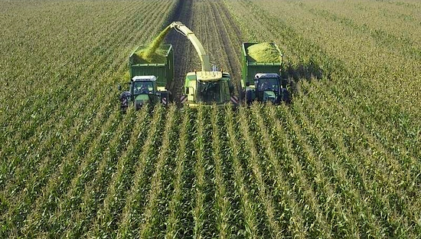

Slide 20
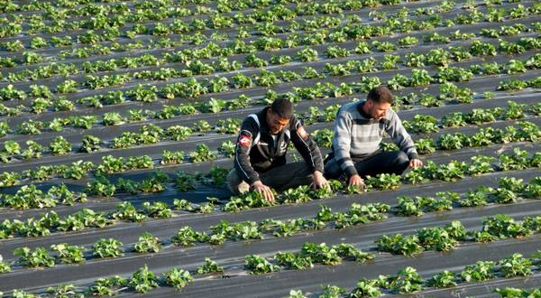

Slide 21
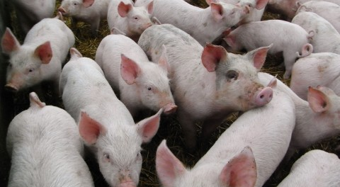

Slide 22
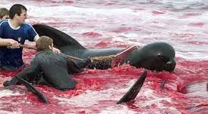

Slide 23
SECONDARY SECTOR:
Industry is particularly modern
Principal industries:
iron, steel, nonferrous metals, chemicals, food processing, textiles and clothing, electronics, construction, furniture and other wood products, pharmaceuticals, medical equipment

Slide 24
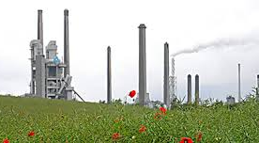

Slide 25
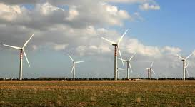

Slide 26
TERTIARY SECTOR
Denmark is a country set in a modern market economy , aimed at the development of the service sector:
Exports
The main exports are meat and dairy products.
Transportation
The most important center in this field is Copenhagen, the capital. The city is well connected with the rest of the continent and with Sweden
Tourism
The capital, Copenhagen, is often described as a fairy- tale town and metioned for its clean streets

Slide 27
Traditional food
Frikadeller (fried meatballs , often accompanied by potatoes and various kinds of sauces)
Roast pork with pork rind ( accompanied by red cabbage and boiled potatoes with sauce) is one of the traditional Danish dishes
Fish: herring ( sild ) and cod ( torsk )

Slide 28
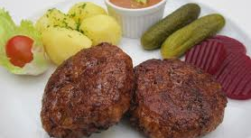

Slide 29
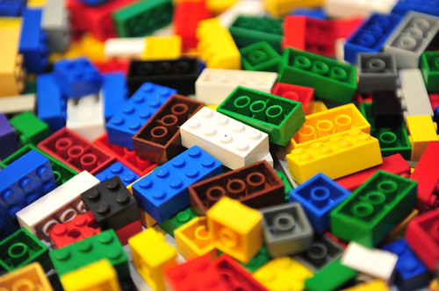
Curiosity (1)
The well-known children’s game in bricks, called Lego, is a danish invention. The idea of the name “Lego” comes from two danish words “Lege” and “Godt” (giocare bene)

Slide 30
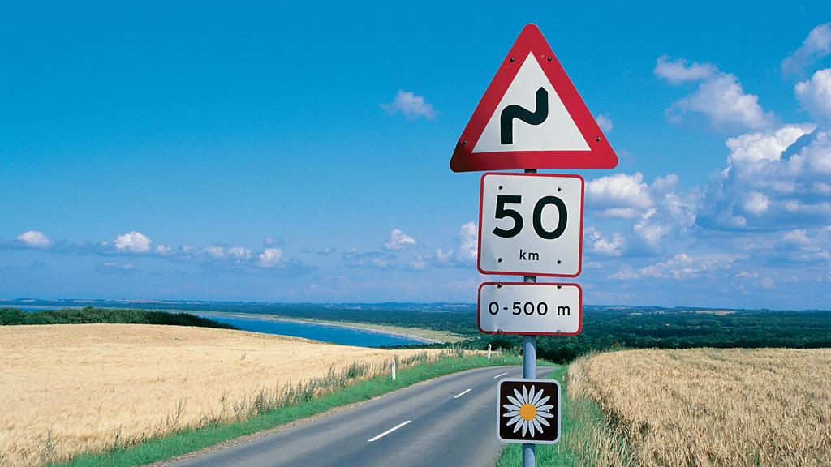
Curiosity (2)
In Denmark there are special routes named “Daisy”. They are in all 14, there are panels road with a white daisy. These paths are about 3500 km of narrow, winding streets that pass through small villages, coltivated fields…

Slide 31
Thanks for the attentions!!
Gabriele Contardi
Edoardo Honegger

