Slide 1
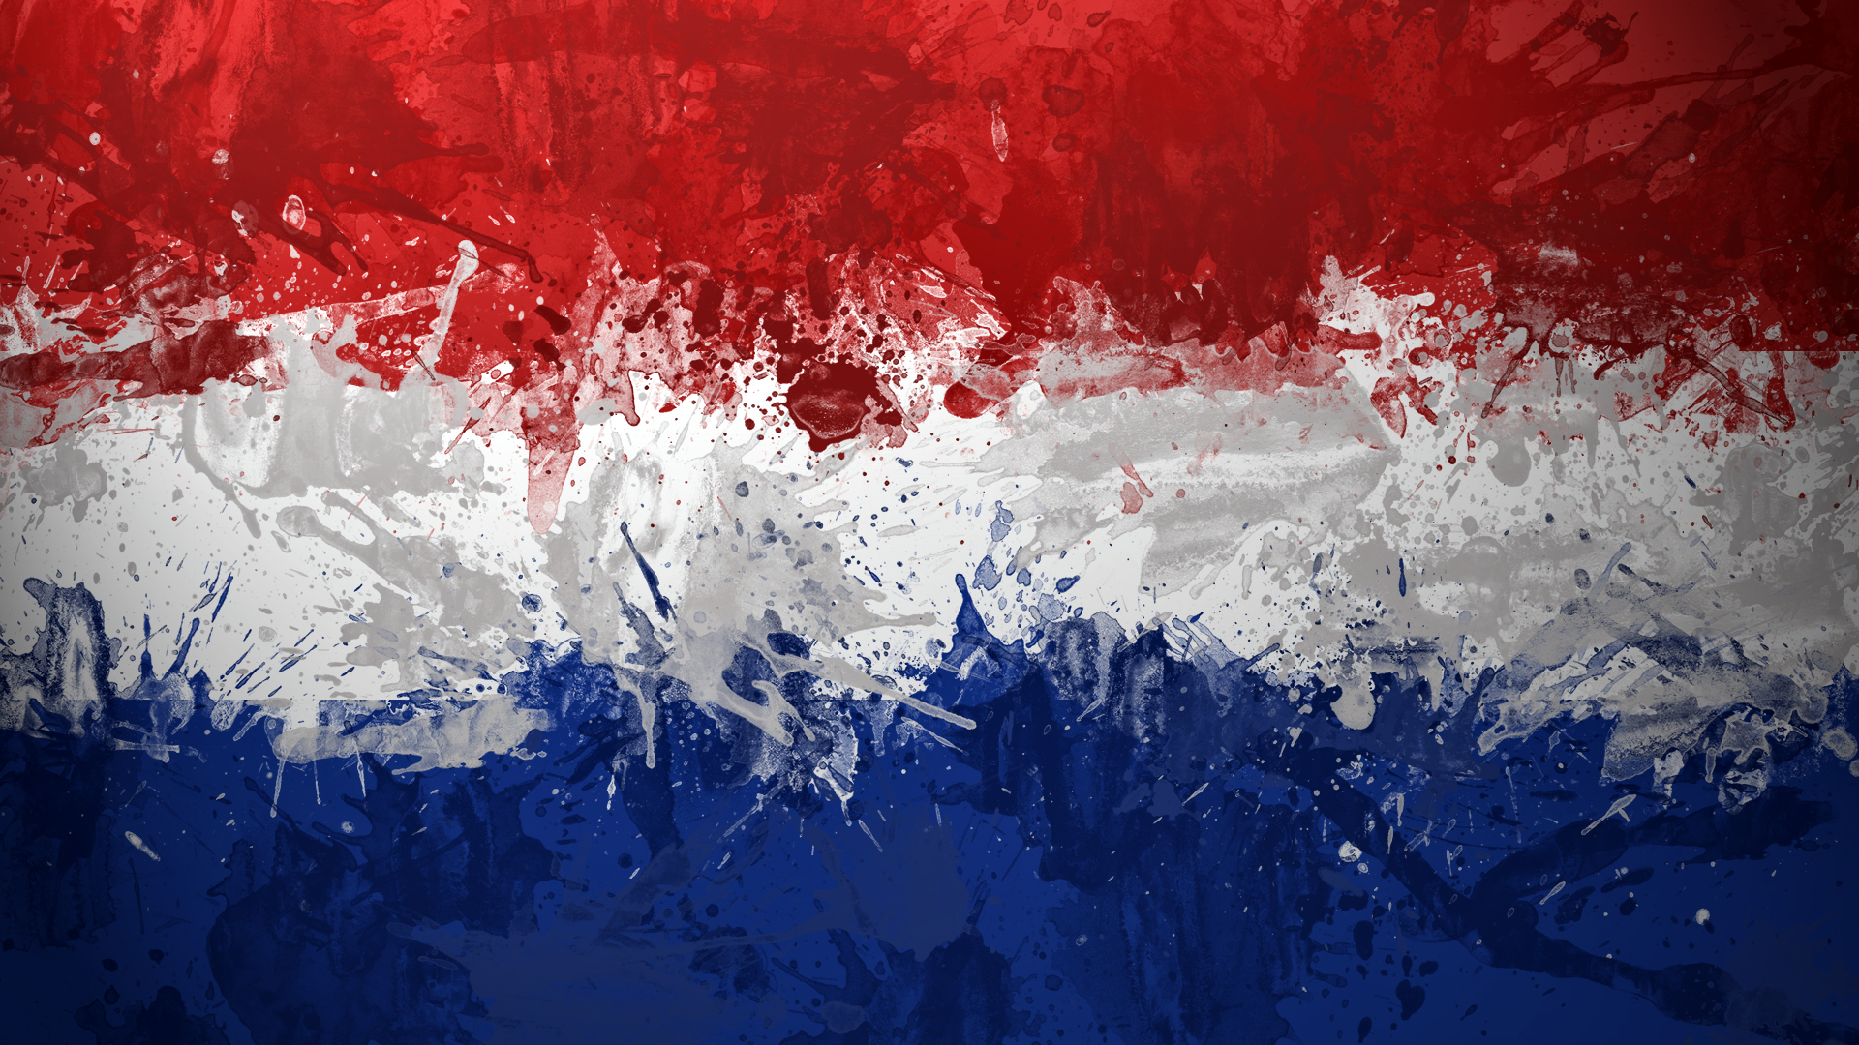
THE
NETHERLANDS
By Pietro Alamia and Giacomo Fabiani

Slide 2

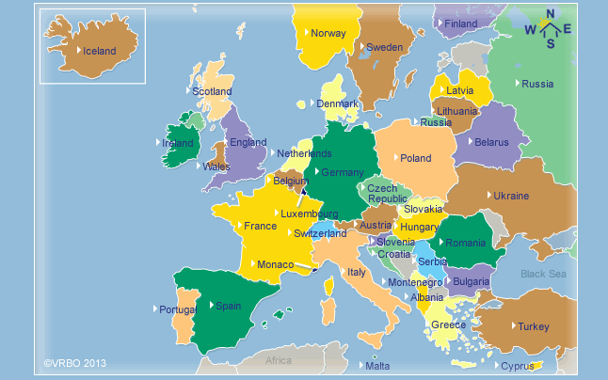
WHERE ARE THEY?

Slide 3
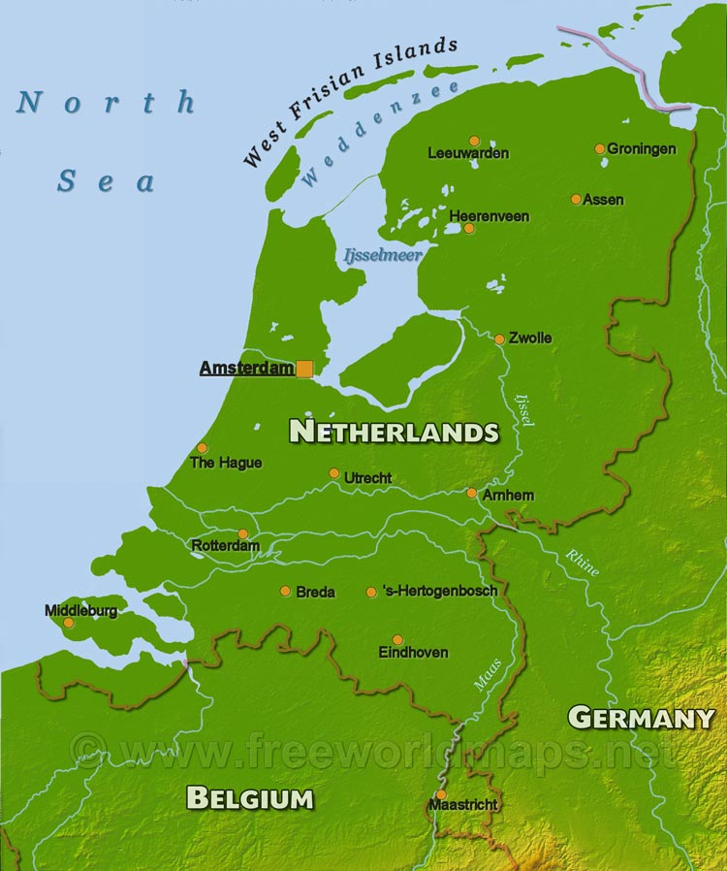
PHYSICAL GEOGRAPHY
The Netherlands border Germany to the South East, Belgium to the South West, North Sea to the North and Frisian Islands to the West.
The Netherlands are very flat, because the higher site is on 321 meters above sea level. There are many rivers that flow in the North Sea. The most important are the Rhine, the Mosa and the Scheldt.
The climate is temperate and marine, with cool summers and mild winters.

Slide 4
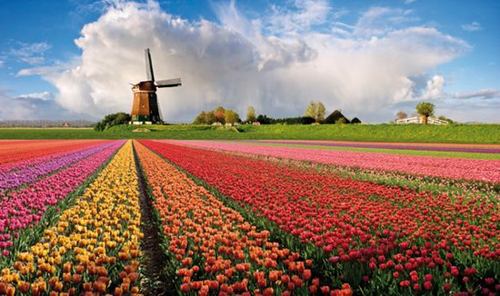
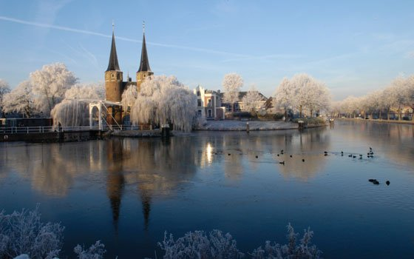
TYPICAL DUTCH PLACES

Slide 5
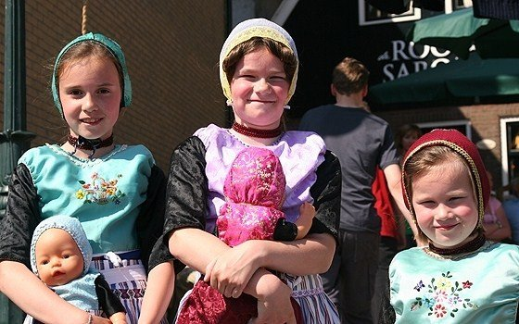
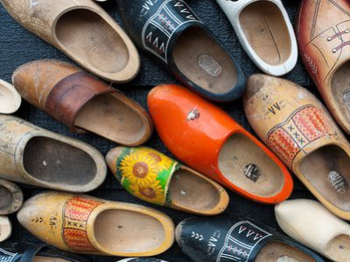
POPULATION
The population of the Netherlands is about 16 millions. There is an high population density.
Dutchmen is another name of the Netherlanders. Their language is Dutch.
The 41% of the population isn’t religious, the 31% is Roman Catholic and the rest is Protestant and Muslim.

Slide 6
ECONOMY
The main crops are grains, potatoes, sugar beets, fruits, vegetables and flowers, especially tulips; breeding and fishing are very important.
The Netherlands are rich in mineral areas: people extract natural gas, oil, peat, limestone and mineral salt. The Netherlands are rich in arable lands.
The main industries are agroindustries, metal and engineering productions, electrical machinery and equipment production, chemicals, petroleum, construction, microelectronics.
People export machinery and equipment, chemicals, fuels, flowers and plants and import other machinery, chemicals, foodstuffs and clothes.
Dutch currency is the euro.

Slide 7
HISTORY
The Netherlands were born in 1579 and their name was United Provinces. The United Provinces were a protestant republic that fought against Spain and France. After the war they formed a unique kingdom with Belgium but in 1830 Belgium become an independent country. In first World War Netherlands were neutral but in second World War Germany invaded them. The Netherlands were freed by American troops. Nowadays the Netherlands are a kingdom and the king is Guglielmo Alessandro.

Slide 8
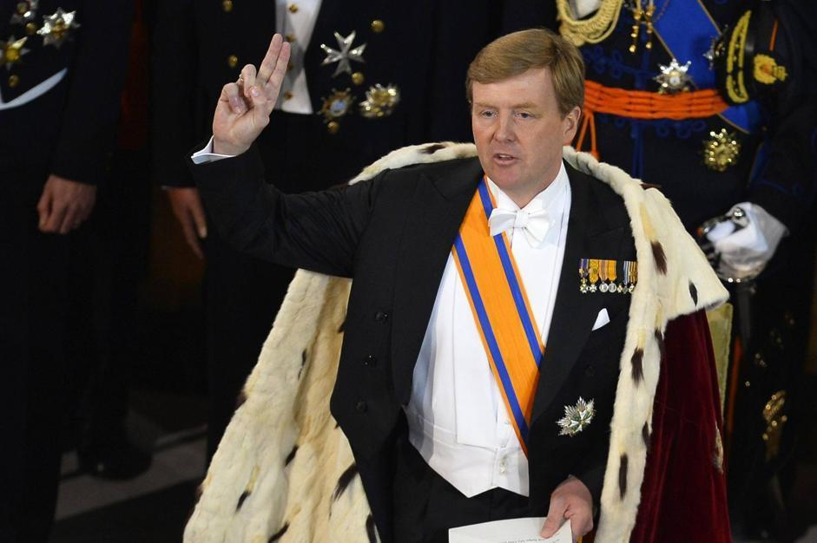
KING GUGLIELMO ALESSANDRO

Slide 9

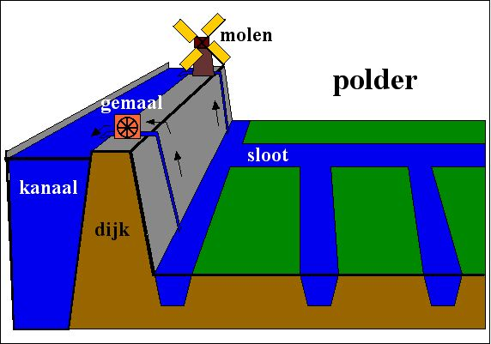
POLDERS AND DIKES
In the 1287 the terpen and dikes that held back the North Sea failed and water flooded the country. A new bay, the Zuiderzee (South Sea), was created over former farmland. The Dutch worked to push back the water of the Zuiderzee, building dikes and creating polders, pieces of lands reclaimed from water. Canals and pumps are used to drain the land and keep it dry. Windmills had been used to pump excess water off the fertile soil.

Slide 10
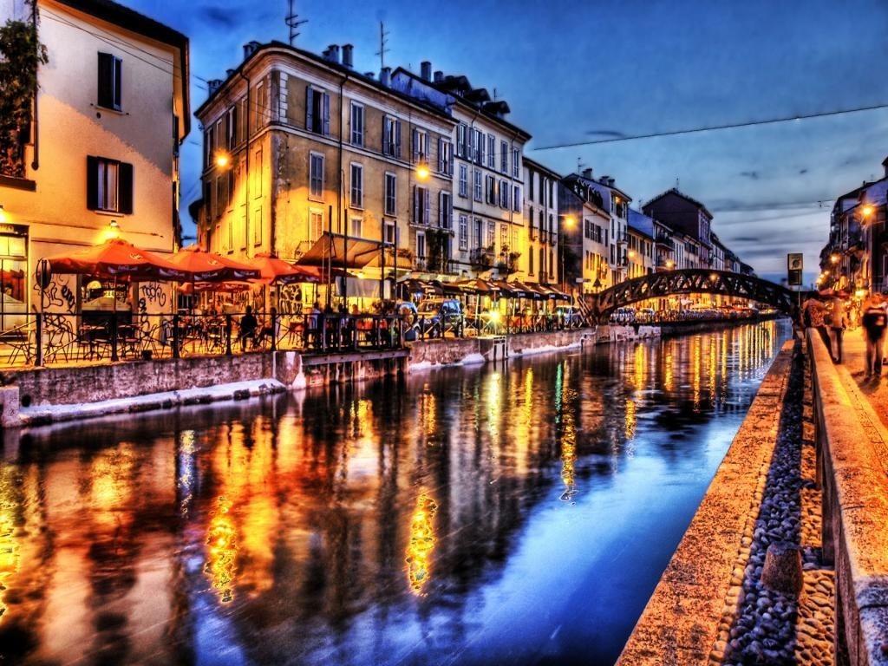
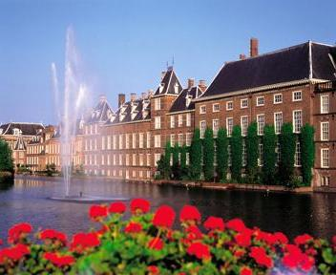
MAIN CITIES
The main cities of the Netherlands are Amsterdam, the capital city, The Hague, the administrative centre, and Rotterdam, the largest port in Europe.

Slide 11
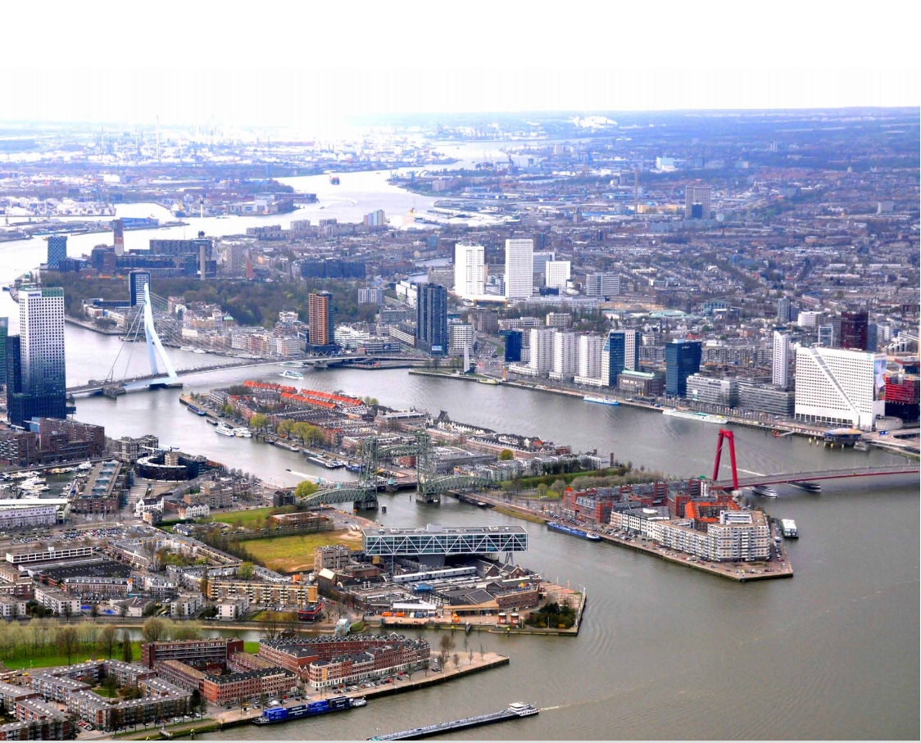
ROTTERDAM PORT

Slide 12
CULTURE
In the Netherlands, in summer, there’s a great jazz party, in The Hague: the «North Sea Jazz».
Dutchmen use frequently the bike. It’s used more than the car because the the territory is flat and the bike is practical, economic and it doesn’t pollute.
In the Netherlands there are many windmills; in the past they were used to grind wheat and now they are monuments.

Slide 13
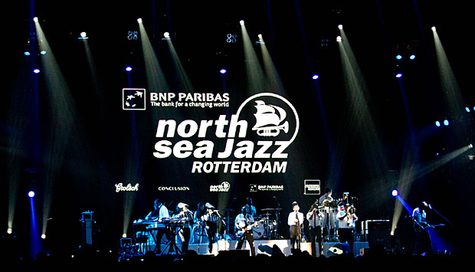
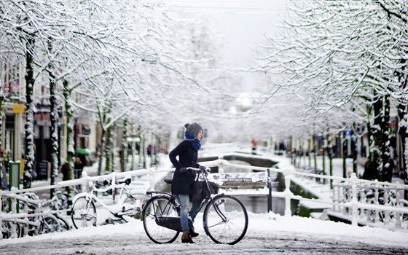
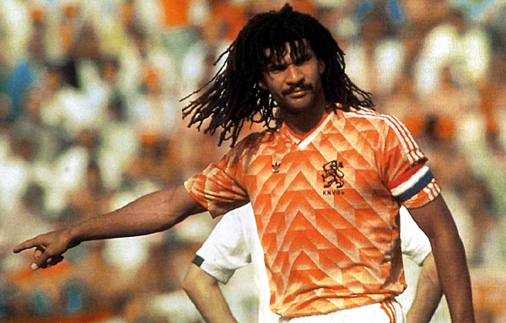
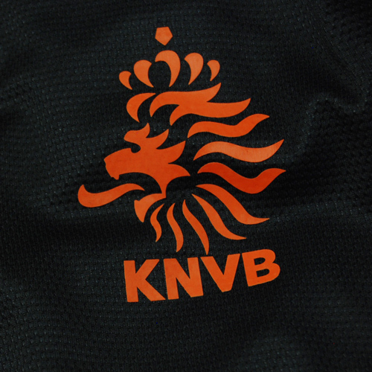
W THE NETHERLANDS!

Slide 14
THE END

